Slide 1
Weekly meeting 15
Shengya Guo, CR/AVS3, 09.10.2024

Slide 2
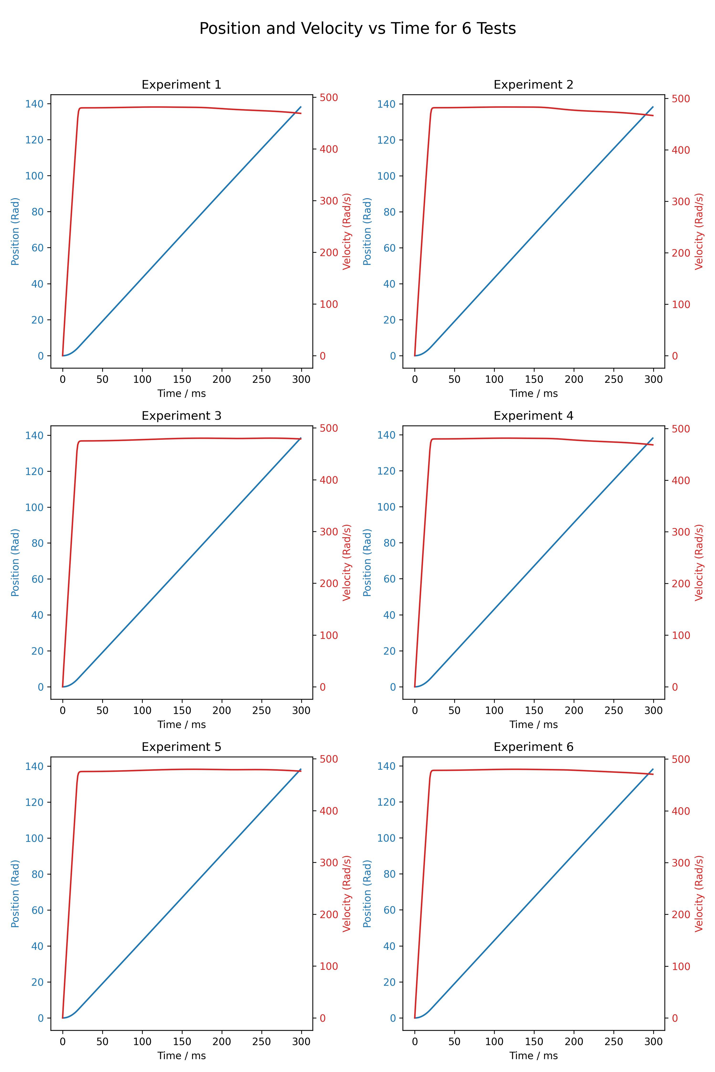
With the old EMB model, no noise in obs
Free the restriction of the position

Slide 3
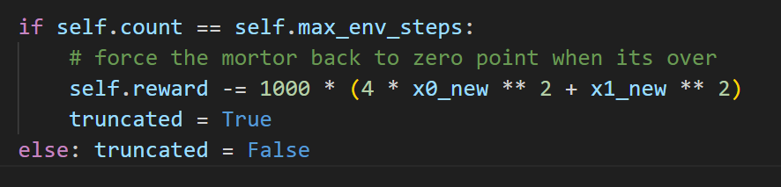
Force back to zero point
Add punishment to if the motor don’t go back to zero point at the end of the episode
This is a sparse reward

Slide 4
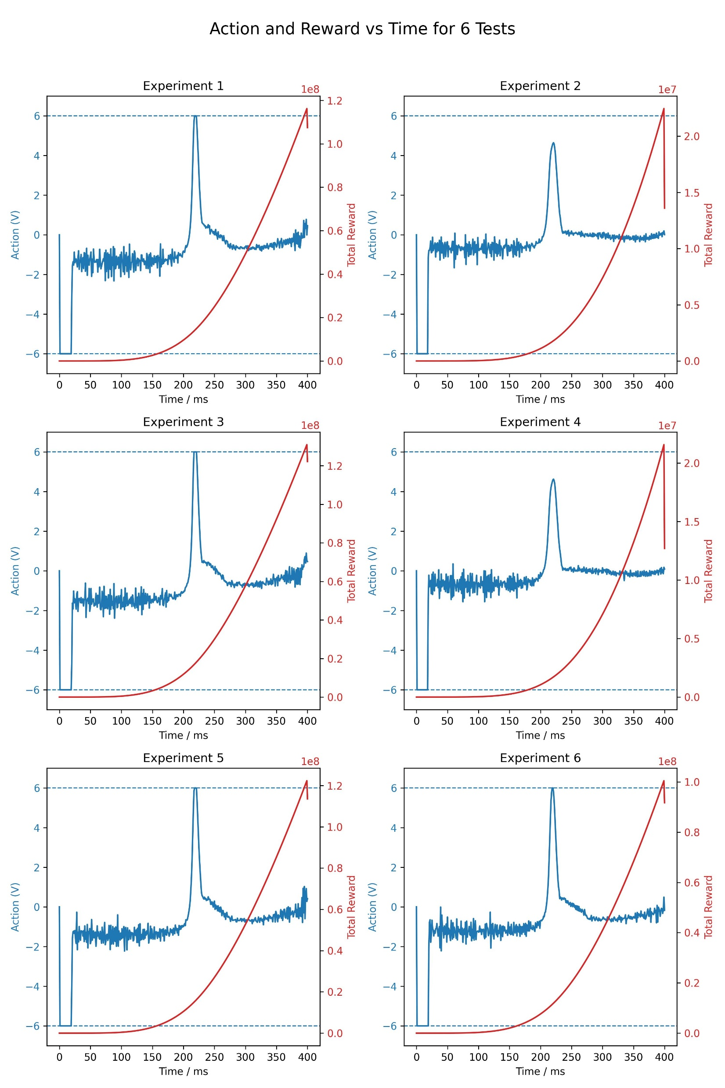
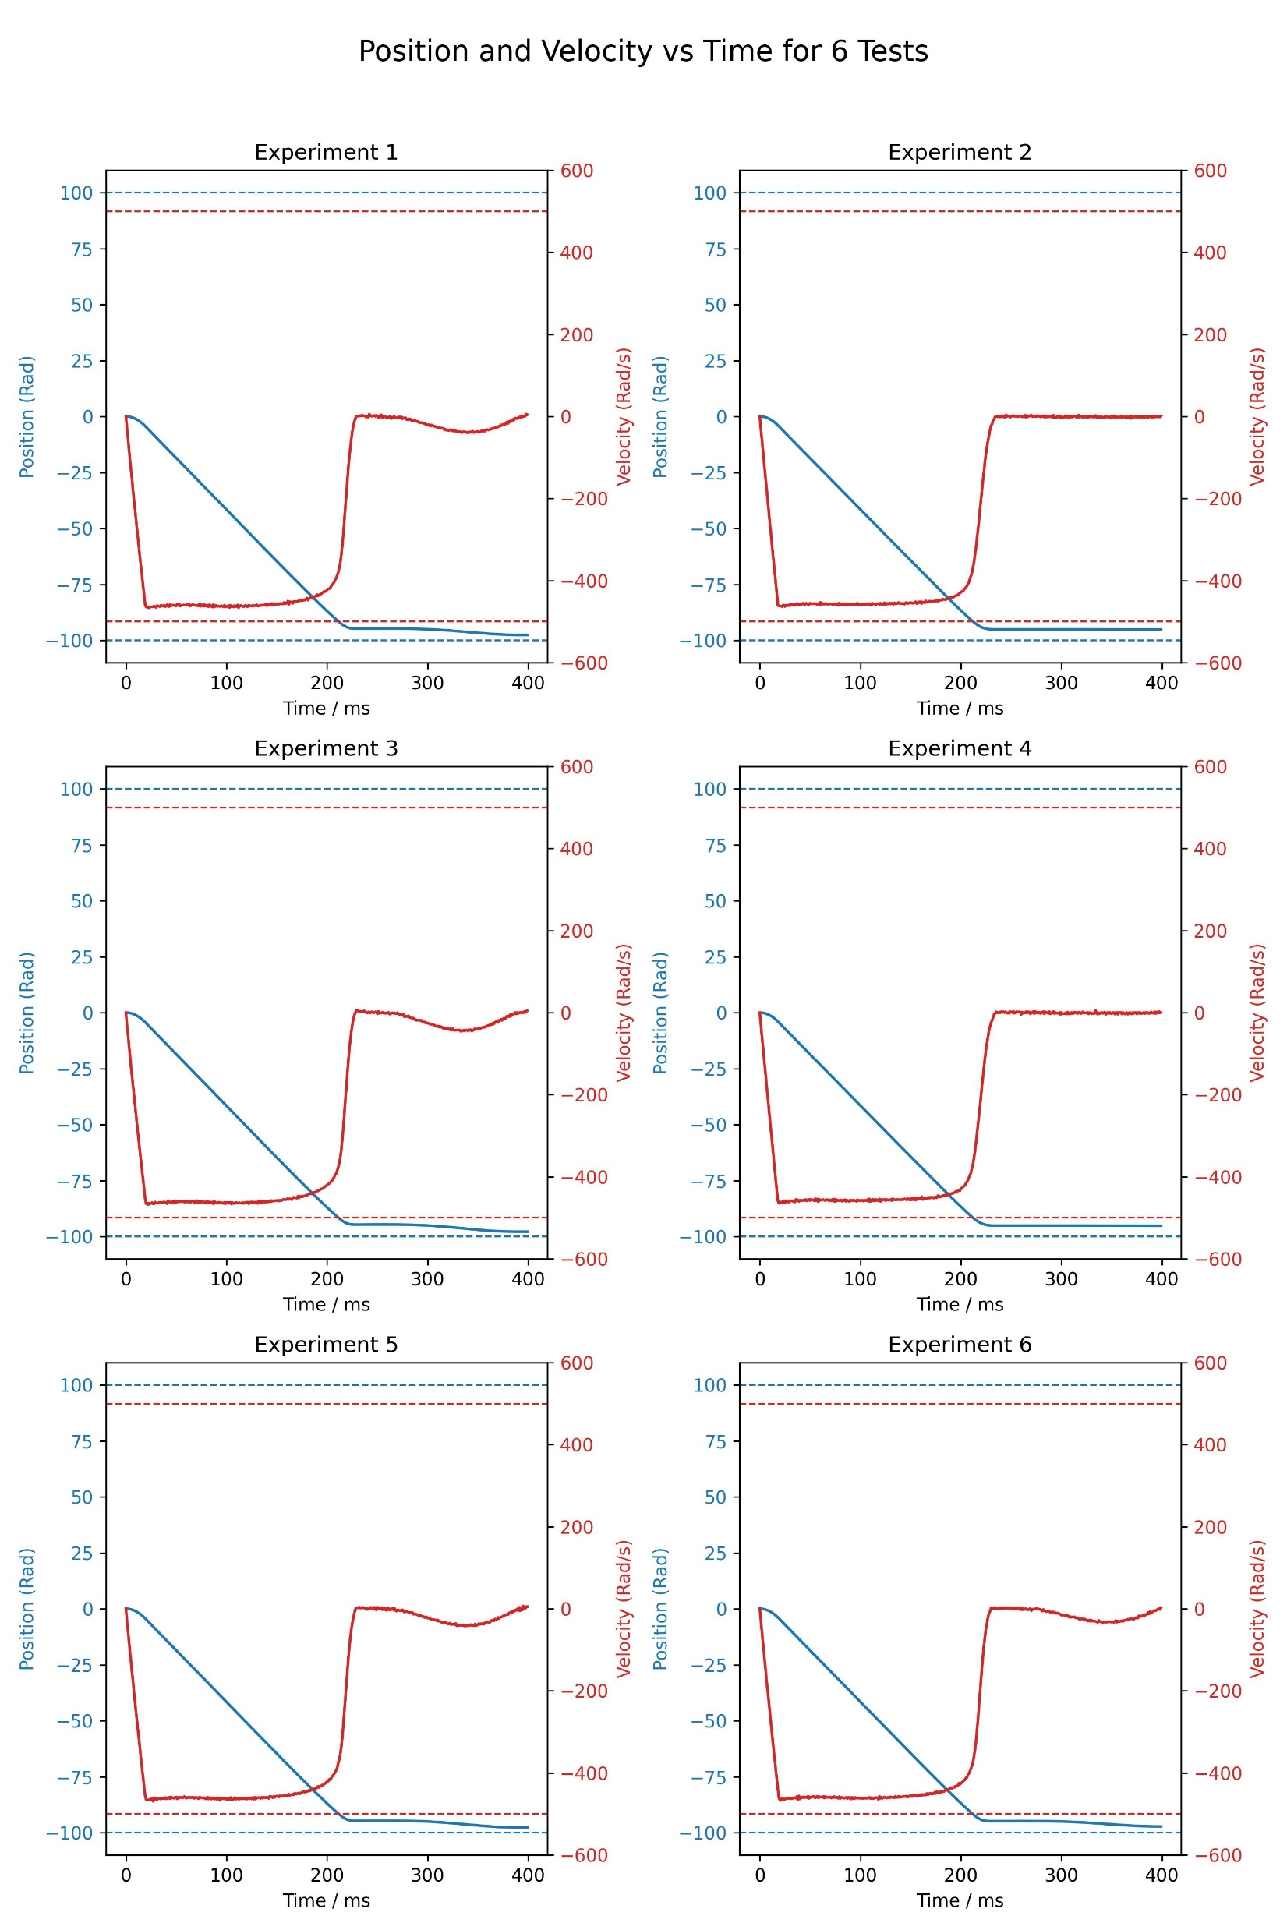
Why the FIM still growing when speed =0
The caculation of FIM

Slide 5
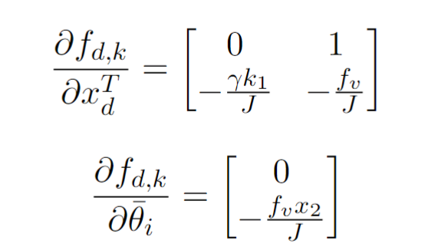
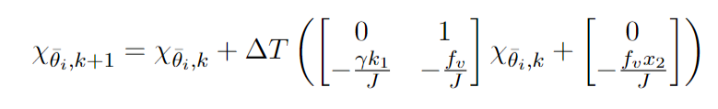
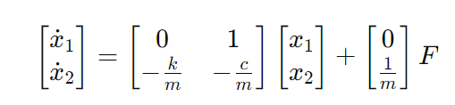
Why the FIM still growing when speed =0
The caculation of FIM
The calculation of Chi be interpreted as a mass-damper system.
When velocity x2 stay zero after running a while, it is equal to no input added on the mass-damper system.
The second term of Chi will oscillate with gradually decreasing amplitude until it stop at 0.
But the first term of Chi will not back to zero. This let the FIM always accumulating with time, even when the velocity already zero.

Slide 6
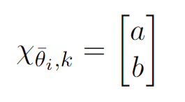
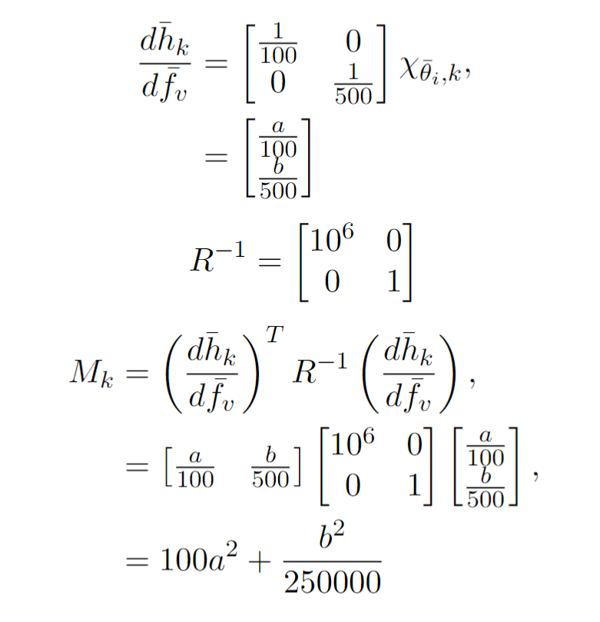
Why the FIM still growing when speed =0
The caculation of FIM
We have a high-precision position sensor with a standard deviation of 1e-3
And a less accurate velocity estimator with a standard deviation of 1
Result: The FIM is strongly influenced by the first term in the state vector Chi

Slide 7
Different input for actor and critic
Change the pos range to (-10,100)
actor input (x1_nosie, x2_nosie, k), critic input (x1, x2, k, fv, FIM)
3. Reward = (1-k/k_max)^2 * R - (k/k_max)^2 * P

Slide 8
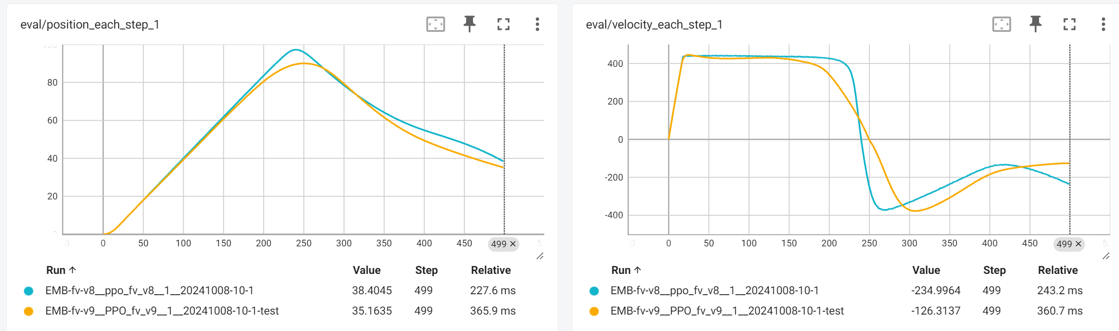
Different input for actor and critic
Blue: Same input for actor and critic
Yellow: Reduced input for actor

Slide 9
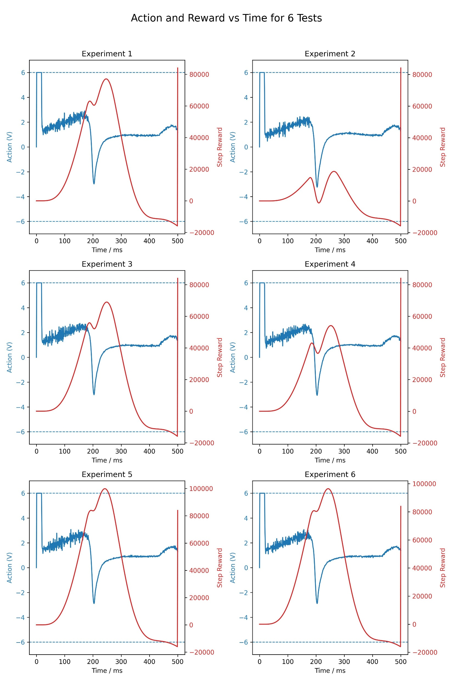
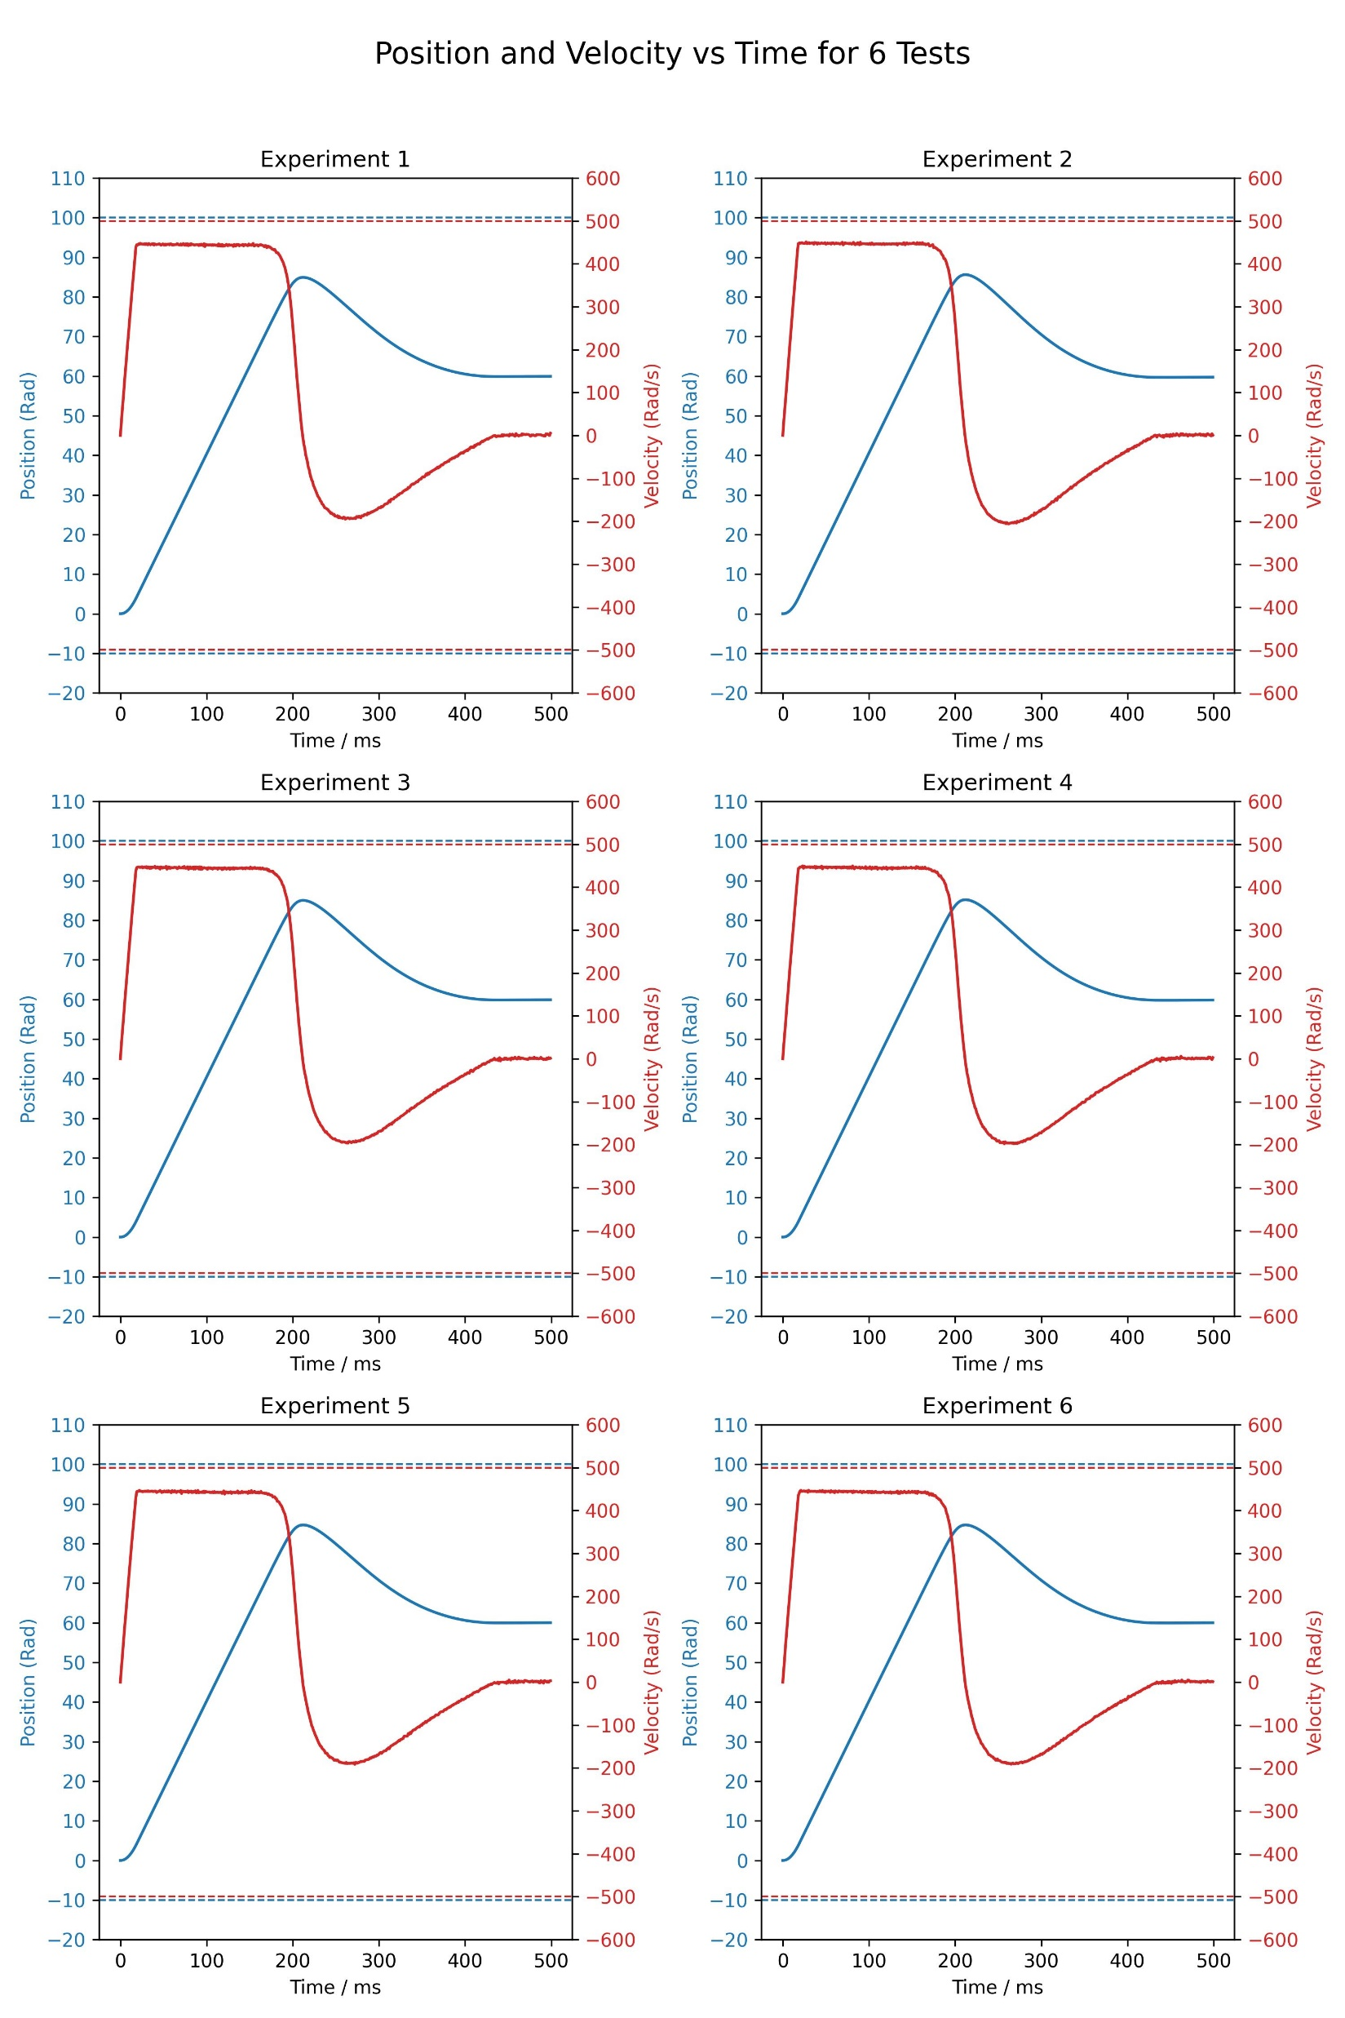
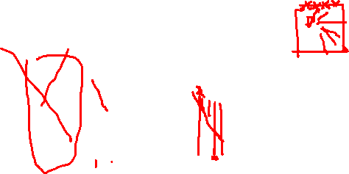
Difficulty for the final point

Slide 10
Next
Use k1 for next parameter (25, 50)
Form 400ms, use pid or design a trajectory and then add punishment to the distance to the trajectory, to set EMB back, if it is succeed, add the FIM form 400ms to 500ms in the reward at the last step

